Slide 1
Data Level Parallelism
Prepared by Shafia Hussain

Slide 2
Flynn’s Taxonomy
Proposed in 1966 by Michael J. Flynn
SISD:
Processors that execute single instruction in a cycle that involve just two operands (i.e add r1,r2,r3)
MIMD:
Multi-issue processors (VLIW or superscalar).
SIMD:
Single instruction is issued which operate on multiple data e.g. multiplying a matrix row with column
MISD:
Same stream of data flows through an array of processors that perform different operations on it. No example but some authors consider pipelined machines as MISD

Slide 3
SIMD vs MIMD
If we use MIMD for vector operation we have to determine the amount of ILP in code while for SIMD we already know the data-level parallelism in code intended e.g. matrix computation in scientific computing, image and sound processing and machine learning algorithms
SIMD is more energy efficient as single instruction can launch multiple operations.
Easier on Programmer as one doesn’t need to thing about scheduling (so that max instructions are issued and executed in each slot) during coding , but still achieve parallelism through multiple data operations in parallel

Slide 4

SIMD Implementations
Vector Architectures:
Specialized processors with multiple pipelines in parallel for multiple operation
Multimedia SIMD instruction set extensions:
Consider Vector Architectures a superset of SIMD extensions. It is a coprocessor to execute multimedia instructions like intel MMX (multimedia extensions) in1996, which were followed by several SSE (streaming SIMD extensions) versions in the next decade, and they continue until this day with AVX (advanced vector extensions).
GPUs:
Similar to vector architectures but they have their own distinguishing characteristics, because of the ecosystem in which they evolved i.e used alongwith a separate processor and system memory

Slide 5
Vector Architecture
Principle of operation
Scattered Data brought from mem to registers
Operation on registers (so dozens of register-register operation for single instruction)
Data is written back to memory
Key Features
Large register Files:
Each register is a vector of registers.
Deeply pipelined Loads and stores (e.g using Interleaved memory)
Deeply pipelined so cycle time is reduced. So latency is amortized over register length (e.g 32 elements) and thus data can be exchanged between register and main memory (no need of data cache)
Multiple parallel pipelines(lanes):
Different functional units having different pipelines perform operations on multiple data in parallel. So parallelism is achieved without the design complexity of out of order processor

Slide 6
RISC-V RV64V RISCV with RVV Extension
License-free, royalty-free RISC ISA.
Anyone can freely use to implement and extend
Vector extension of RISCV called RVV is still under development. RV64V refers to RISCV base instructions plus the vector extension

Slide 7
RV64V Components
Vector Registers:
Each vector register holds a single vector. RVV has 32 vector registers and width of each element is user defined by writing to configuration registers. The mvl (maximum vector length) is set by processor (implementation). Vector register file needs to provide enough ports to feed all the vector functional units. The read and write ports, which total at least 16 read ports and 8 write ports, are connected to the functional unit inputs or outputs by a pair of crossbar switches because bus has limitations as it is shared (so that max connections b/w the two are available with min interconnect)
Vector functional units
Functional units are fully pipelined a new operation can be started on every clock cycle. A control unit is needed to detect hazards, both structural hazards for functional units and data hazards on register accesses. We assume an implementation of RV64V has five functional units. For simplicity, we focus on the floating-point functional units.

Slide 8
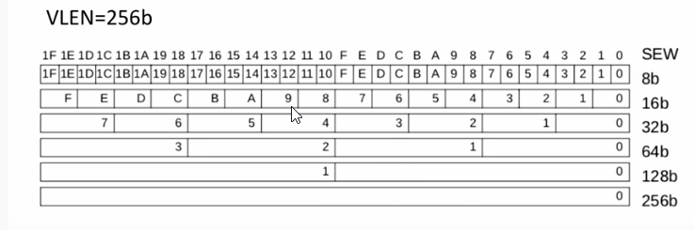
Vector Registers: Same size different width of elements

Slide 9
Components
Vector load/store unit
To loads or store a vector to or from memory. Fully pipelined in our hypothetical RV64V implementation so that words can be moved between the vector registers and memory with a bandwidth of one word per clock cycle, after an initial latency. Also handles scalar loads and stores.
A set of scalar registers:
Scalar registers can likewise provide data as input to the vector functional units, as well as compute addresses to pass to the vector load/store unit. These are the normal 31 general-purpose registers and 32 floating-point registers of RV64G.

Slide 11
RV64V Instructions
Some instructions are shown in table ahead.
It only shows .vv instructions i.e. both operands are vectors.
There are also .vs versions of these when one operand is a scalar.
In examples code is written without any suffix. Because the operands determine the version of the instruction, we usually let the assembler supply the appropriate suffix after recognizing the operands. For example vector regs and scalar regs may have different nomenclature so that assembler can differentiate
Data type and size info is also not shown in the instruction. Two schemes can be used
Instruction name (opcode) specifying the operand type and size it will operate on. We will need many tables like the one being discussed
Associate the data type with the register that is to be used as operand. So before operation, instructions are used to configure registers to specify their width and data type (and length of vector).

Slide 13
Dynamic register typing
Scientific, multimedia, machine learning; they all need different data types and sizes.
What is Dynamic Register Typing
Dynamic typing also lets programs disable unused vector registers. Enabled vector registers are allocated all the vector memory as long vectors. For example, assume we have 1024 bytes of vector memory, if 4 vector registers are enabled and they are type 64-bit floats (8 bytes), we could give each vector register 256 bytes/8bytes =32 elements. Here is 32 is maximum vector length.
Advantages
Without Dynamic typing context switch is also slower because state to save is large. Because we can also disable registers not in use
Conversions between different size operands can be implicit depending on the configuration of the registers and we don’t need to execute extra instructions for conversion later. e.g when two operands are single precision floats but destination is double precision. Without dynamic typing, operation is only determined by opcode i.e. an instruction could be for double precision or single precision
In RVV vector length (no. of elements) is dynamically changed based on configuration set for data width and total vector size.

Slide 14
How Vector Processors Work: An Example

Slide 16
Example
RV64G executes 2+32*8 = 258 instructions for the code whereas RV64V executes 8 instructions

Slide 17
Example

Slide 19
Vector Execution Time
Execution time of a sequence of vector operations primarily depends on three factors
The length of the operand vectors
Structural hazards among the operations
the data dependences.
All modern vector computers have vector functional units with multiple parallel pipelines (or lanes)
We will assume that all functional pipes are fully pipelined so that new operation can be started at each cycle.
So each lane at steady state (ignoring initial latency) will give one result per cycle (e.g multiplication of two elements in two operand vectors).
If multiple parallel instructions (of different functional pipes or lanes) are executing in parallel, we call it a convoy.
Although only one instruction is issued in a cycle but since overlapping time is so large in comparison, so we call it a convoy.
For instruction to be in a convoy, they must not have structural hazard.

Slide 20
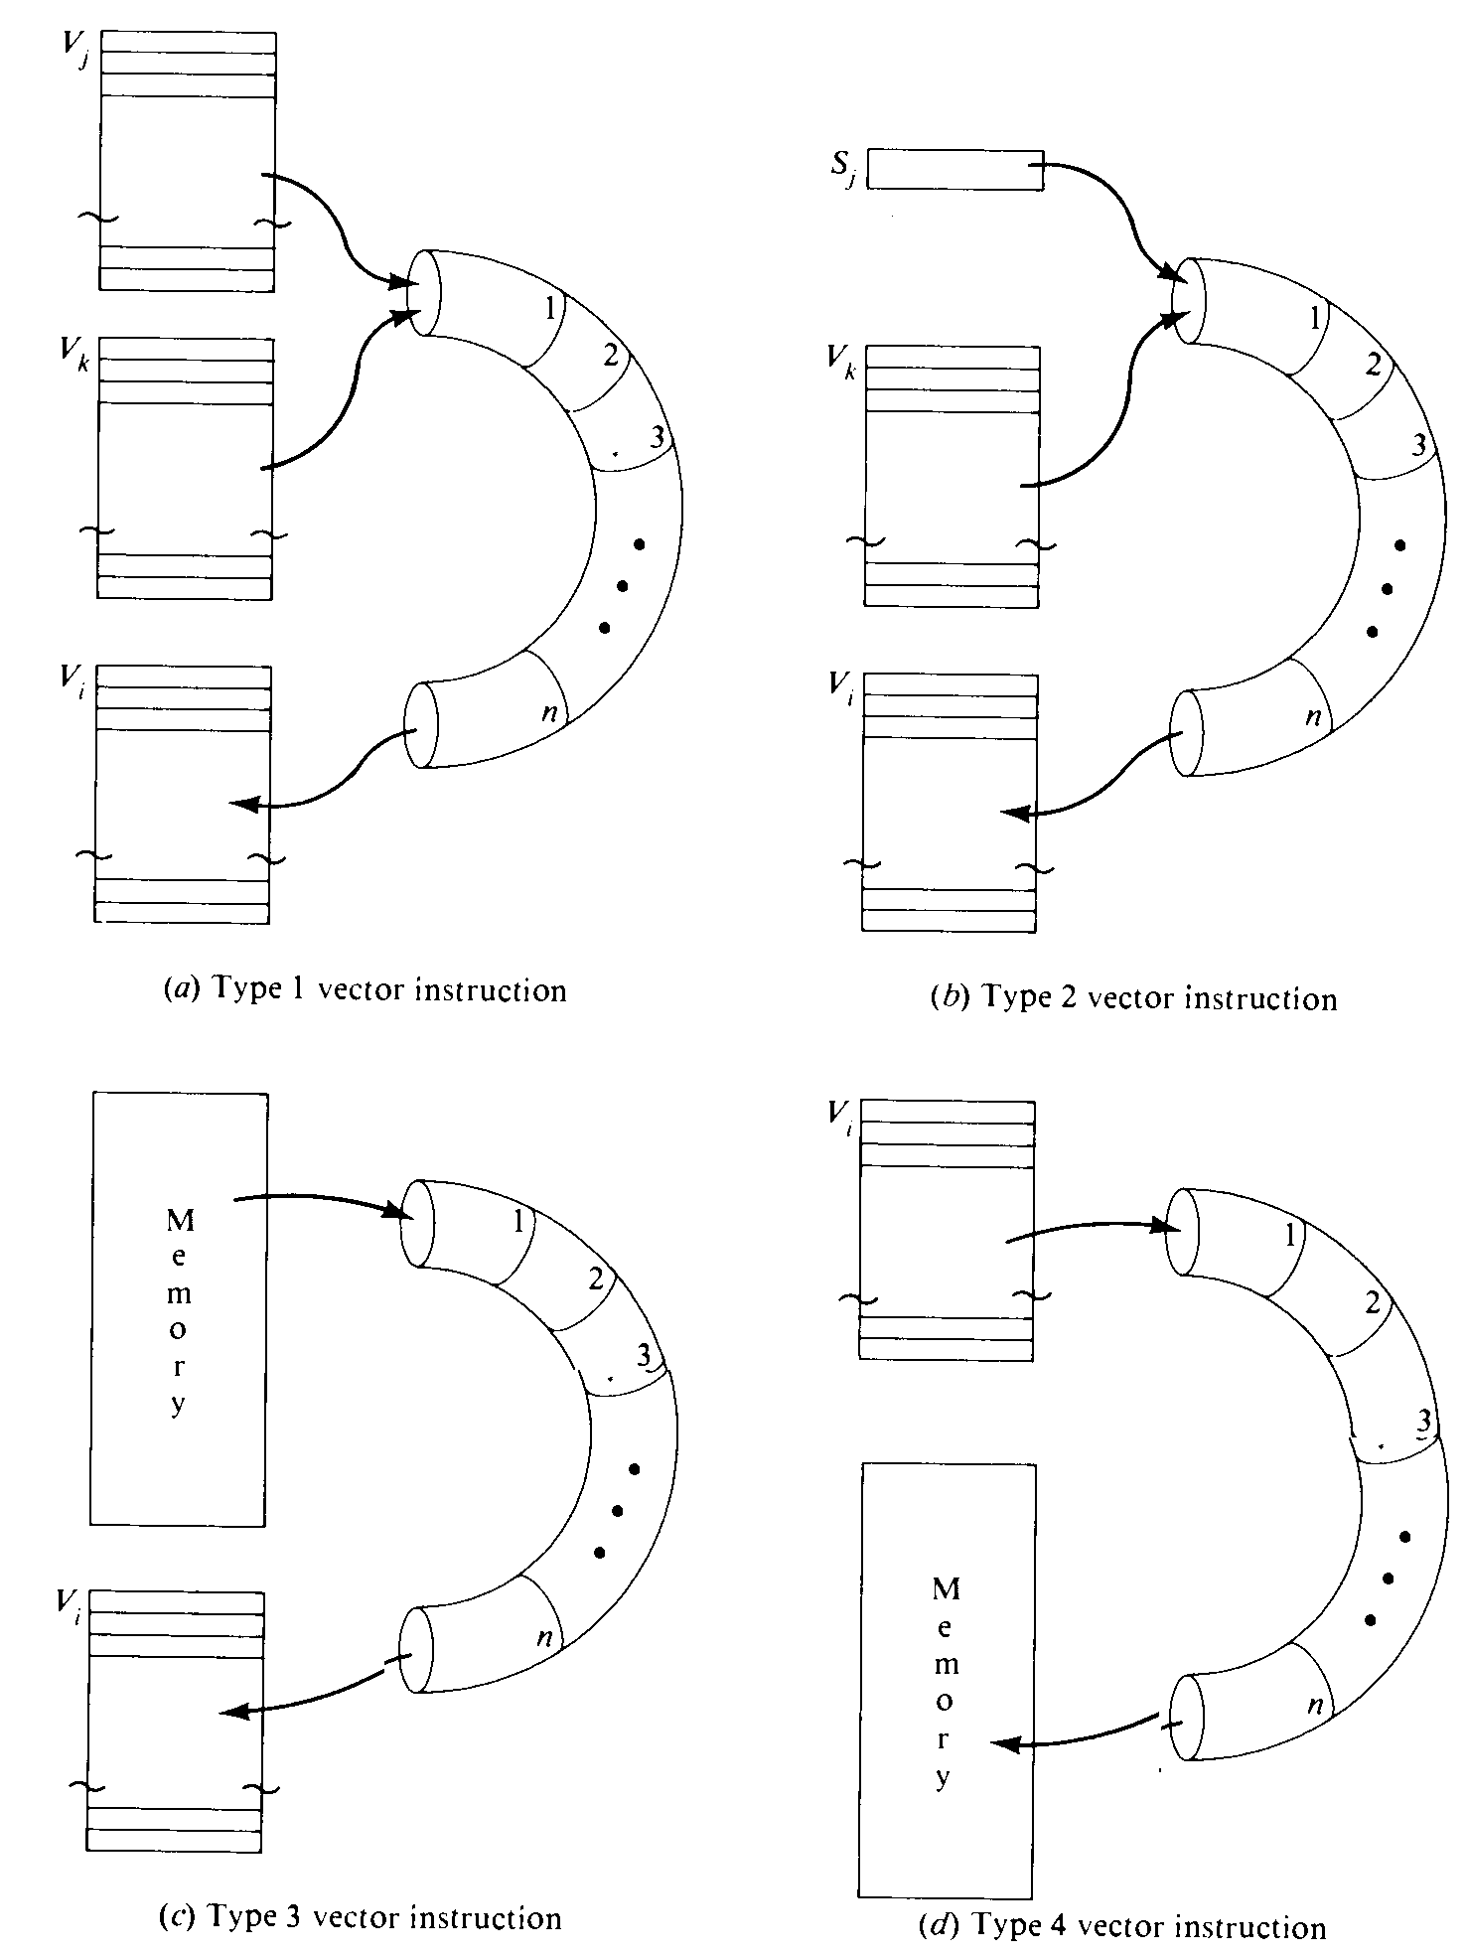

Slide 21
Vector Execution Time Structural Hazard
When an instruction is issued, the required functional pipes and operand registers are reserved for a number of clock periods determined by the vector length.
Subsequent instruction which need the same registers or functional units cannot be issued, otherwise it will result in structural hazard.
The diagram on next page illustrates the scenarios that can cause structural hazard

Slide 22
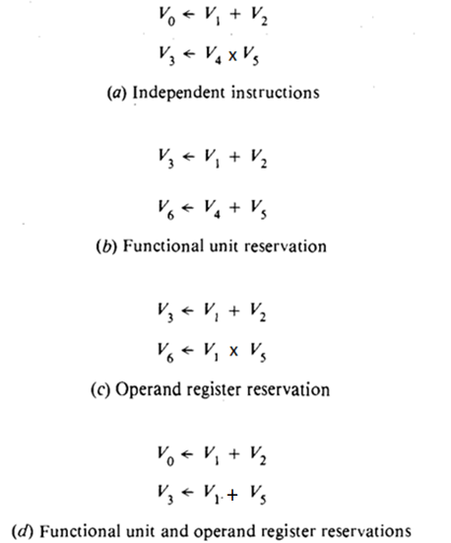
Vector Execution Time Structural Hazard

Slide 23
Vector Execution Time Chaining
Each instruction should take cycles equal to vector length (ignoring initial latency which includes functional pipe depth ).
So if dependent instruction have to wait like the instructions that have structural hazard, this will severely degrade performance.
In such a case dependent instruction will be sent in the next convoy. But chaining allows us to only wait until the first result is ready.
It is implemented by providing the functionality to read and write a register at the same time

Slide 24
Vector Execution Time Chaining
The functional units and registers of a vector processor can be connected like a chain to provide the data dependency.
The instruction that depends upon a preceding instruction, starts reading when the first result is written.
This way the latency of depending operation is approximately equal to the no stages of functional pipe producing result

Slide 25
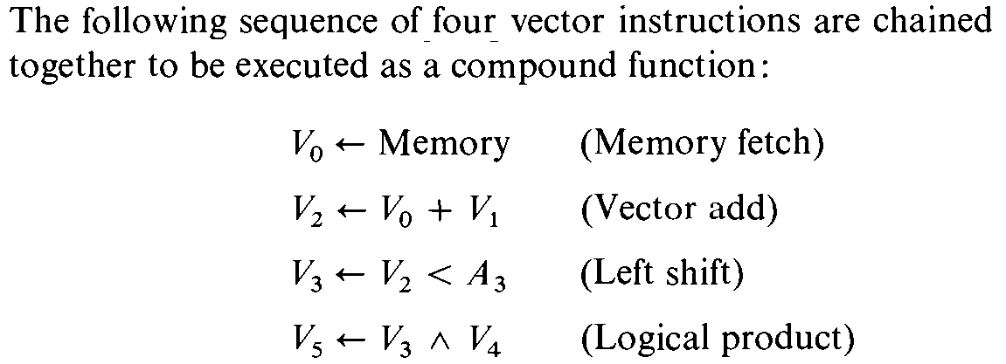
Example

Slide 26
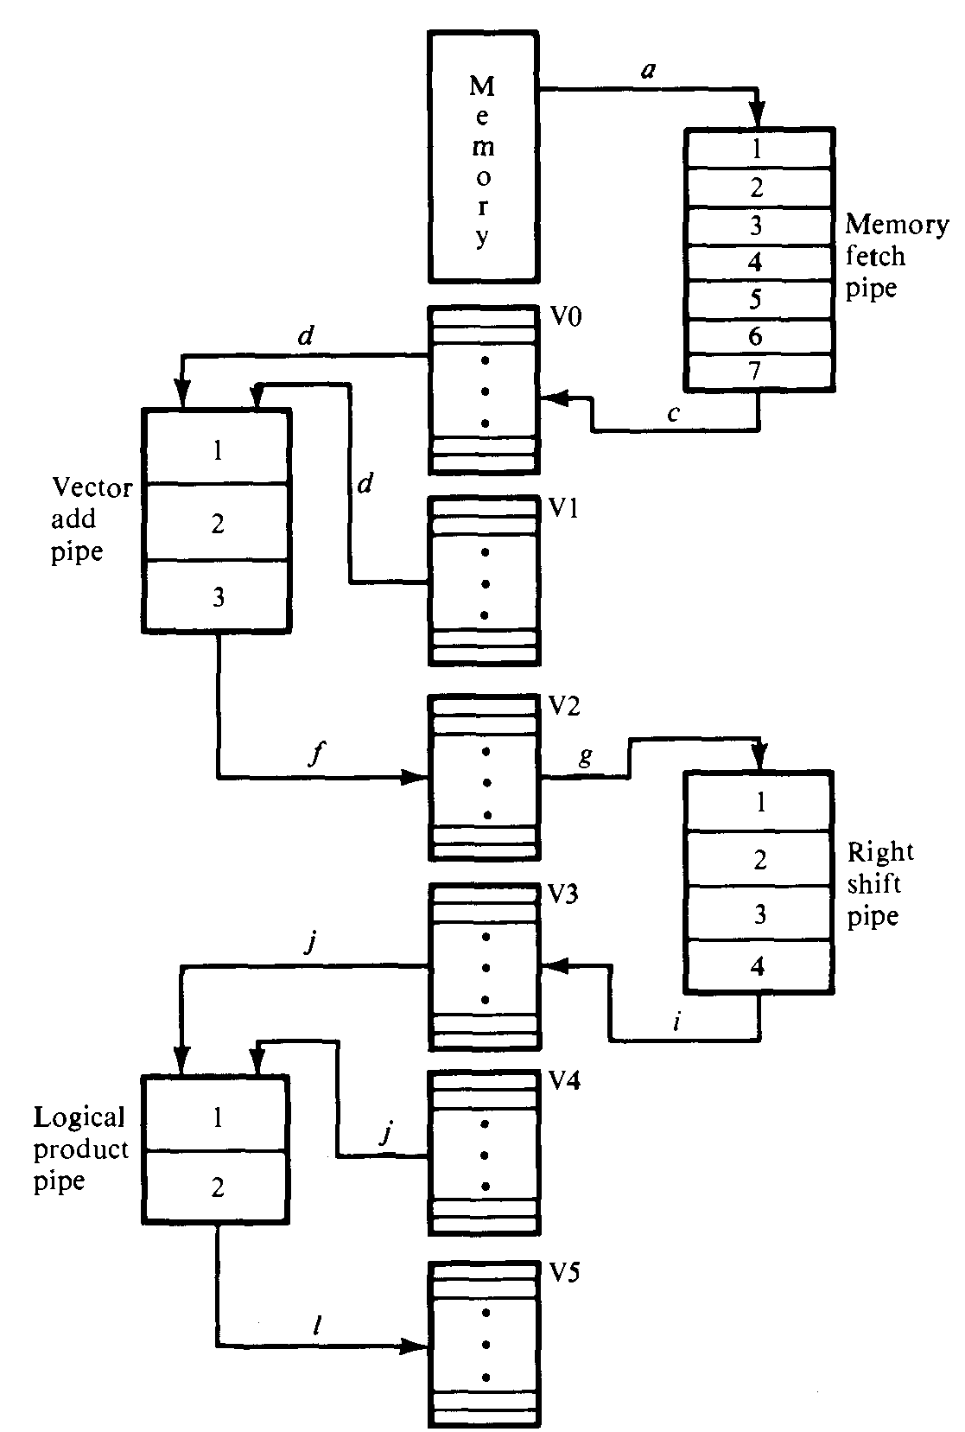

Slide 27
Vector Execution Time
To calculate vector execution time we use the term chime, which is the time taken to execute one convoy.
Thus a vector sequence that consists of m convoys executes in m chimes.
For a vector of length n, the no. of clock cycles is equal to m*n.
Here again we have simplified it, because one instruction is issued in a cycle, so for all independent instructions in a convoy, k-1 no of cycles should be added for each convoy where k is no of instruction.
For dependent instructions in a convoy, there are latency cycles until 1st result is ready
The approximation is accurate for long vectors

Slide 28
Example

Slide 29
For 32 bit vectors , 3 chimes means 32*3 = 96 clock cycles.

Slide 30
Multiple Lanes: Beyond One Element per Clock Cycle
We have seen uptil now one lane per functional unit.
Multiple lane per functional unit can be added so that a group of vector element executes per clock cycle.
This way performance is increased without adding any complexity
Designers can also reduce clock rate to decrease dynamic energy without net decrease in performance

Slide 31
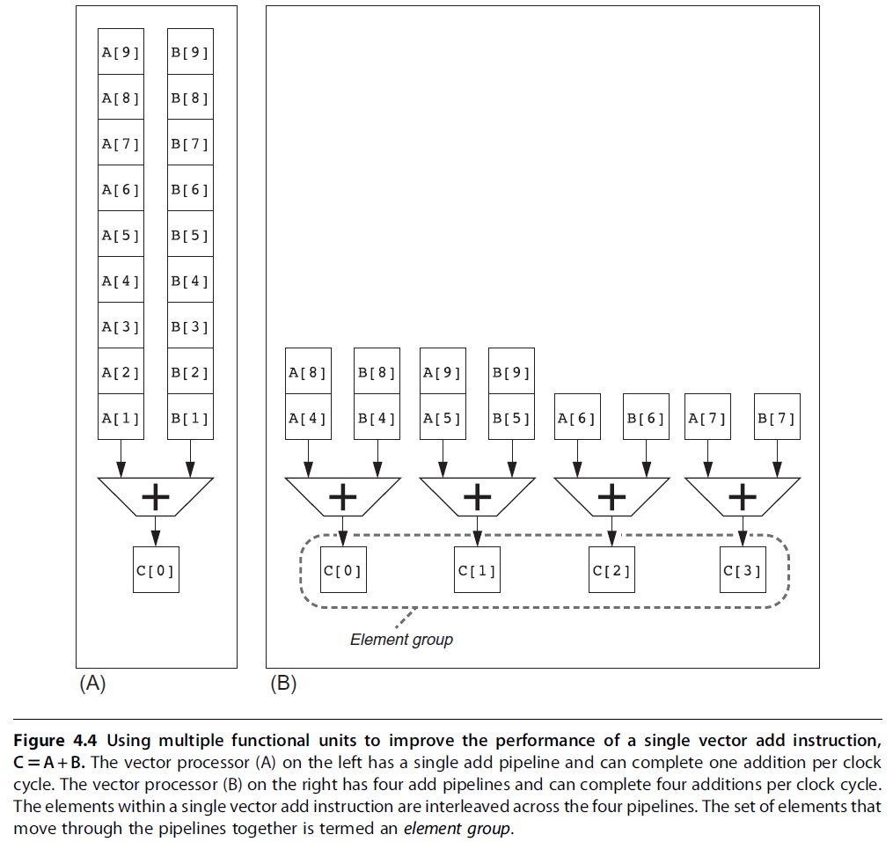

Slide 32
Vector-Length Registers: Handling Loops Not Equal to 32
The arrays on which processing is to be done quite possibly will not be equal to the mvl of the vector register. It may be greater or less.
In some cases the length may also be not known at compile time.
In RVV there is vector length register that controls the length of any vector operation.
But it works only when vector length is less than mvl.
This way cycles are not wasted in processing vacant elements. For example if there are only 16 element to be processed in a vector register of size 32, then mvl is 16
Notes:
MVL -> Maximum Vector Length

Slide 33
Vector-Length Registers: Strip Mining
When vector length in memory is greater than mvl of register a technique called strip mining is used.
See next slide

Slide 34

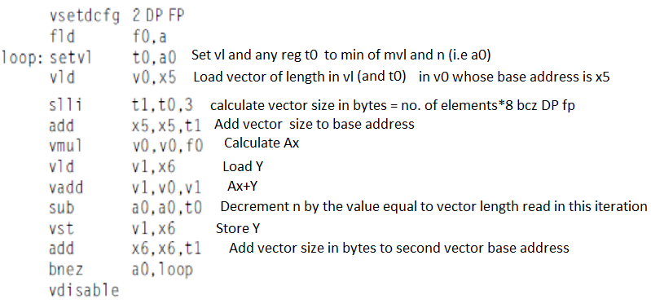
Here is t0 is mvl length (register size) and a0 is length of the vector to be processed which is multiples of mvl + some remainder
Setvl sets vector operation length to the minimum of to,a0

Slide 35
Predicate Registers: Handling IF Statements in Vector Loops
This loop cannot be normally vectorized because of presence of if statement.
So control dependency is a hurdle for vectorization
The common extension for this capability is vector-mask control.
RV64V provides predicate registers which hold Boolean value (true or false).
They can be enabled or disabled like vector registers. When enabled, all entries are true.
When vector operation is performed with predicate registers enabled, destination register is only modified for elements, for which corresponding predicate register entry is true.
It still gives better performance then normal conditional execution even if there are large no of zeros

Slide 36
Memory Banks: Supplying Bandwidth for Vector Load/Store Units
As studied earlier RAM cycle time is considerably larger than cycle time of processor.
To maintain an initiation rate of one word fetched or stored per clock cycle (after initial latency), multiple independent memory banks are used.
Most vector processors use memory banks, which allow several independent
accesses rather than simple memory interleaving for three reasons
Many vector computers support many loads or stores per clock cycle
Most vector processors support the ability to load or store data words that are not sequential.
Most vector computers support multiple processors sharing the same memory system

Slide 37
Example
Solution:
If we compare processor cycle time with SRAM cycle time, we get 15/2.167 ≈ 7.
So, during the access time of SRAM, each processor can generate (4+2)*7 =42 accesses.
And 32 processors will generate 42*32 = 1344 memory references, so we need 1344 memory banks

Slide 38
Gather-Scatter Operation
Sparse matrices have a lot of zero elements.
To perform operation on only non zero elements, architecture supports gather scatter operation.
Gather: A vector contains addresses of non zero elements (offsets). Elements are acceses from these locations by adding to base address.
Scatter operation is opposite

Slide 39
SIMD Instruction Set Extensions for Multimedia
Intended for multimedia so vector registers are small as compared to vector architecures
No vector length register
No vector mask register.
No gather-scatter operation
Opcode specifies the type and size of operand, that is why a lot of instructions.

